Slide 1
DYNAMIC PROGRAMMING dp
DESIGN AND ANALYSIS OF ALGORITHMS
LECTURER: Nguyễn Thanh Sơn
CS112.L23.KHCL.N12

Slide 2
HOMEWORK
Gmail: 19521482@gm.uit.edu.vn

Slide 3
The shortest path
4
A D
1
11
18
9
2
5
13
S
B
E
T
16
2
5
C F
2
Apply the Dynamic programming, the shortest path from S to T is?

Slide 4
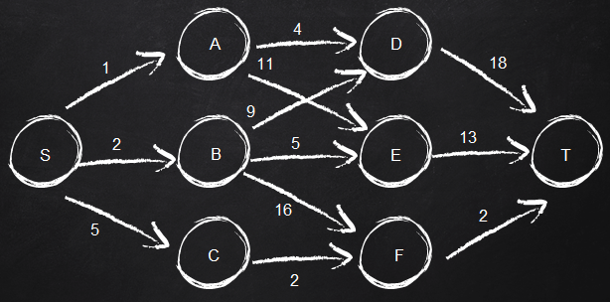
Top-down approach
d_{min} (S, T) = min{d_{min}(S, D); d_{min}(S, E); d_{min}(S, F)}
d_{min} (S, T) = min{1+d_{min}(A, T); 2+d_{min} (B, T); 5+d_{min} (C, T)}
d_{min}(A, T) = min{4+d(D, T); 11+d(E, T)}
= min{4+18; 11+13} = 22.
d_{min}(B, T) = min{9+d(D, T); 5+d(E, T); 16+d(F, T)}
= min{9+18; 5+13; 16+2} = 18.
d_{min}(C, T) = 2+d(F, T)
= 2+2 = 4.
d_{min} (S, T) = min{1+22; 2+18; 5+4}
= 9.

Slide 5
Bottom-up approach
d(S, A) = 1; d(S, B) = 2; d(S, C) = 5
d_{min}(S, D) = min{d(S, A)+d(A, D); d(S, B)+d(B, D)}
= min{1+4; 2+9} = 5.
d_{min}(S, E) = min{d(S, A)+d(A, E); d(S, B)+d(B, E)}
= min{1+11; 2+5} = 7.
d_{min}(S, F) = min{d(S, B)+d(B, F); d(S, C)+d(C, F)}
= min{2+16; 5+2} = 7.

Slide 6
Bottom-up approach
d_{min} (S, T) = min{d_{min}(S, D)+d(D, T);d_{min}(S, E)+d(E,T);d_{min}(S, F)+d(F, T)}
= min{5+18; 7+13; 7+2}
= 9.

Slide 7
thanks!
Any questions?
You can review these slides on our team's GitHub

